Slide 1
EXTEND
Extending understanding, efficiency and reach of Agricultural Extension Officers

Slide 2
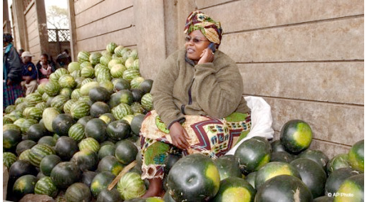
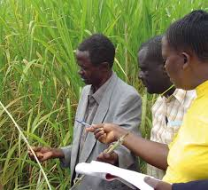
Introduction
Agriculture forms a significant portion of the economies of all African countries (NEPAD, 2013)
Most Sub-Saharan Countries have a setup within the Ministry of Agriculture that comprises of Extension Officers who are in direct contact with farmers.

Slide 3
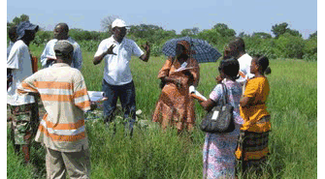
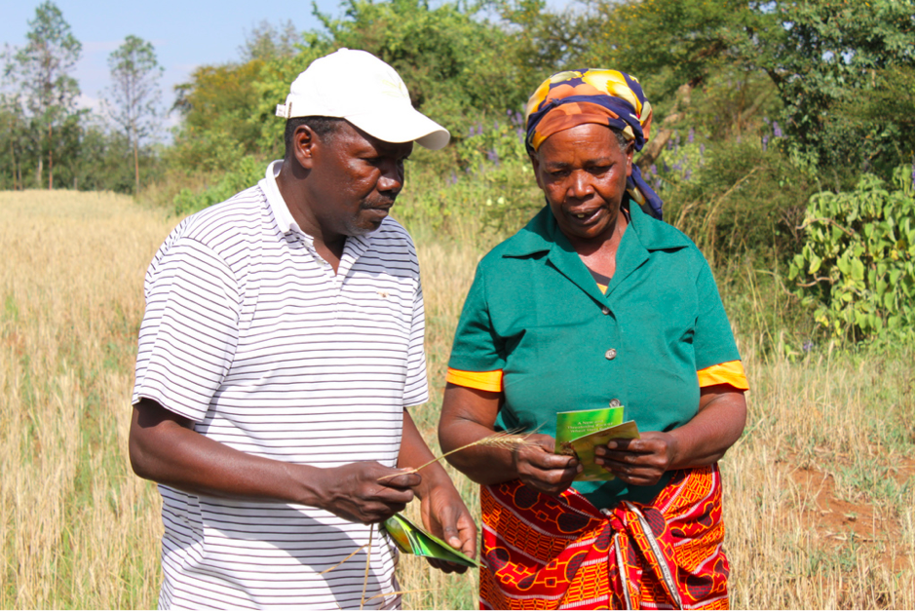
Information channels used in rural Africa are based on trust and familiarity. Agricultural extension workers act as teachers, mentors and are the trusted source of Agricultural Information. They understand the “language of farmers”
Notes:
Underscore the two barries that extend will overcome

Slide 4
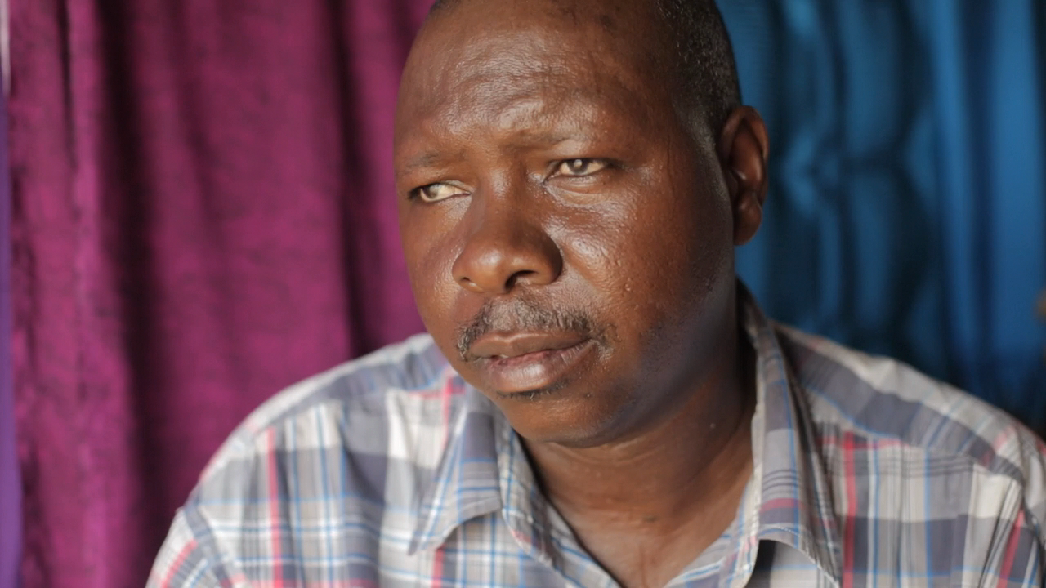
The Problem

Slide 5
The Problem
Farmers don't get access to timely accurate information
Decision making is based on experience and not any current quantitative analysis methods
Current SMS systems are generic and do not provided geolocated data as accurately as we would prefer.
Trusting the source enough to use it.
A data interpreter is usually necessary

Slide 6
Solution: EXTEND
Improve information transfer to Agricultural Extension Officers (EO) and in turn enable farmers make timely and informed decisions.

Slide 7
DEMO

Slide 8
The Business Model
Subscription model for extension officers
Provide premium API’s that allow access to relevant data by interested agricultural service providers
Pay as you go Model for certain value additions (Surveys, SMS notifications)
Platform enabling financial institutions reach farmers(Commission-based referral system)
Agriculture ADs

Slide 9
The Team
Madi-Jimba Yahya, Nairobi
Daniel Mbeyah, Nairobi
Gladys Kitony, Nairobi
Pooja Pasawala, New York
David Yong, London
Expertise: Software Engineering/Development, Agri-tech, Finance Modelling & Analysis, Entrepreneurship and Innovation, Sales & Marketing

